Slide 1

Pizza Sales EDA
Created by: Yulindra Tita

Slide 2
Table of contents
{01}
{04}
{02}
{05}
{03}
{06}
Objective
Problem Statement
Tools Used
Problem Solving
About Dataset
Summary

Slide 3


{01}
Objective

Slide 4
Objective
Using Python programming, the goal is to extract invaluable insights for informed decision-making. insights gained from examining major trends, products sold, and sales patterns. The analytics project aims to improve inventory management, operational efficiency, target sales, and product optimization.

Slide 5
{02}
Tools Used

Slide 6



Tools Used
Visual Studio Code (VSCode):
Visual Studio Code is a free source-code editor developed by Microsoft. It provides support for various programming languages, including Python, and offers features such as debugging, syntax highlighting, and Git integration.
Python for Data Analysis:
Python is a versatile programming language widely used in data analysis due to its simplicity and extensive libraries. It offers tools and libraries like pandas, NumPy, scikit-learn, Matplotlib, and Seaborn, making it a preferred choice for data scientists and analysts.
Built-in Jupyter in VSCode:
This means you can create, edit, and run Jupyter notebooks directly within VSCode, without needing any extra tools. It's a seamless experience that lets you write code, see visualizations, and add explanations all in one place.

Slide 7
Tools Used
Pandas:
Pandas is a powerful open-source data analysis and manipulation library for Python. It provides data structures like DataFrame and Series, along with functions for cleaning, transforming, and analyzing tabular data efficiently.
NumPy:
NumPy is a fundamental package for scientific computing in Python. It provides support for large multi-dimensional arrays and matrices, along with a collection of mathematical functions to operate on these arrays efficiently. NumPy is the foundation for many other Python libraries in the data science ecosystem.
Matplotlib:
Matplotlib is a comprehensive plotting library for Python used to create static, animated, and interactive visualizations. It provides a MATLAB-like interface and supports various types of plots, including line plots, scatter plots, histograms, and more.

Slide 8
Tools Used
Seaborn:
Seaborn is a Python visualization library based on Matplotlib. It provides a high-level interface for creating attractive statistical graphics. Seaborn simplifies the process of creating complex visualizations, especially for statistical analysis and data exploration.
Scikit-learn:
Scikit-learn is a popular machine learning library for Python. It offers simple and efficient tools for data mining and data analysis and supports various supervised and unsupervised learning algorithms, including classification, regression, clustering, and dimensionality reduction.

Slide 9
{03}
About Dataset

Slide 10
About Dataset
This dataset contain detailed information about pizza orders, including specifics about the pizza variants, quantities, pricing, dates, times, and categorization details in the year of 2015.
pizza_id | A unique identifier assigned to each distinct pizza variant available for ordering.
order_id | A unique identifier for each order made, which links to multiple pizzas.
pizza_name_id | An identifier linking to a specific name of the pizza.
quantity | The number of units of a specific pizza variant ordered within an order.
order_date | The date when the order was placed.
order_time | The time when the order was placed.
unit_price | The cost of a single unit of the specific pizza variant.

Slide 11
About Dataset
total_price | The aggregated cost of all units of a specific pizza variant in an order.
pizza_size | Represents the size of the pizza (e.g., small, medium, large)..
pizza_category | Indicates the category of the pizza, such as vegetarian, non-vegetarian, etc.
pizza_ingredients | Provides a list or description of the ingredients used in the pizza.
pizza_name | Specifies the name of the specific pizza variant ordered.

Slide 12
{04}
Problem Statement

Slide 13
Problem Statement
These are key indicators to analyze from the pizza sales dataset to gain invaluable insights for optimizing the business.
Revenue trend per month
Revenue trend per days in every month
Pizzas sold:
  By size
  By category
  Sold per day
  Sold per month
Summary and recommendations

Slide 14
{05}
Problem Solving

Slide 15
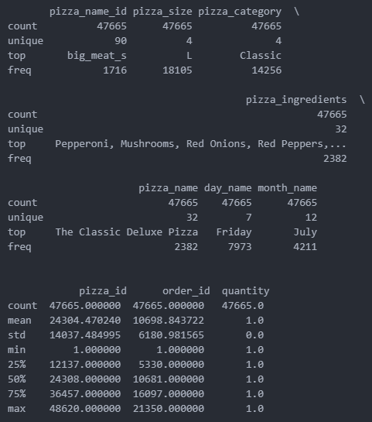
Problem Solving | quick analysis on every columns
From the quick analysis, we know that:
There is 47665 total orders
There is total 32 unique pizza name
Most pizza size shown is L size
Most pizza category shown is Classic category

Slide 16
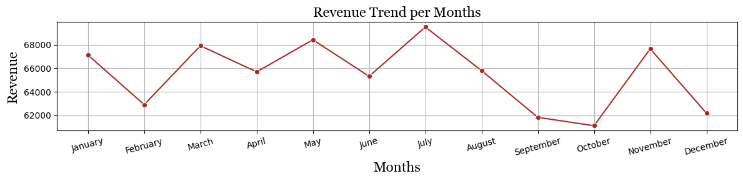
Problem Solving | revenue trend per month
The above graph shows us that the trend is going up and down in sequence. The highest sales occurred in July and the lowest in October. Extreme sales declines occurred after the month of July to October. Based on the graph, there's been five sales increases and seven sales decreases.
This creates a monthly sales imbalance, which requires further identification of problems with the associated divisions, in this case the sales, marketing, analytical teams, and corporate leadership divisions. Problem solving can be done by comparing sales per 2 months in a row, such as January-February, February-March and so on.

Slide 17
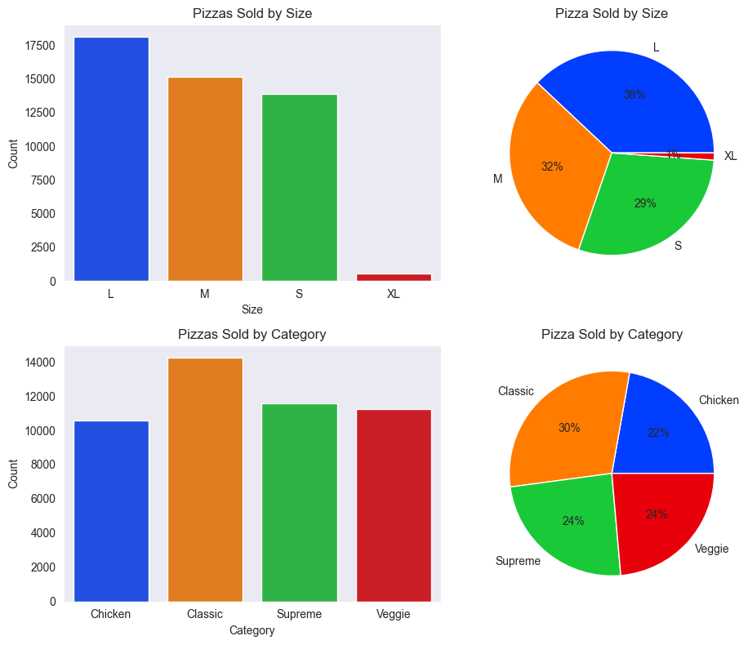
Problem Solving | pizzas sold by size and category
As you can see in the picture, the highest pizza sales by size are on pizza in the size L with percentage on 38%, whereas the lowest pizza sales are owned by pizza in the size XL with the percentage on just 1%.
For the sale of pizza by category, the highest sales belonged to pizza in the classic category with total percentage in 30%, while the smaller sales were held by pizza in the chicken category, with percentage on 22%.
As we can see, the distribution of pizza sales by category, more balanced/equal with almost all categories getting balanced sales.
Compared to the reverse of pizza sales by category, pizza selling by category has a sales imbalance. XL pizza sales are very small, counting only 1% when compared to other sales. This will be a problem for the future, because the process and the manufacturing time as well as the raw materials used are not comparable to the sales that are taking place.

Slide 18
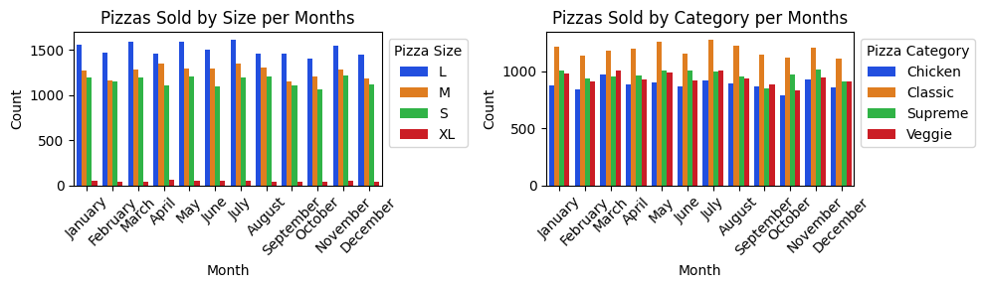
Problem Solving | pizzas sold per month by size and category
The above chart shows the sales of pizza per month based on size and category. As you know earlier, that pizza in size L and classical category is the pizza with the most sales. The sales of both types of pizza are stable, proving to be the highest sales in any month. This is definitely a positive trend for the company, by carrying out further evaluations to increase both of these products so that sales continue to rise.
While the sales for a size XL pizza, it has to be thoroughly evaluated, whether increasing promotions and variations, or choosing to discontinue sales for that type of pizza. The chart on pizza sales based on non-classic categories shows a seemingly stable distribution. The sales that occurred were evenly divided into each category other than the classic that topped the sales.

Slide 19
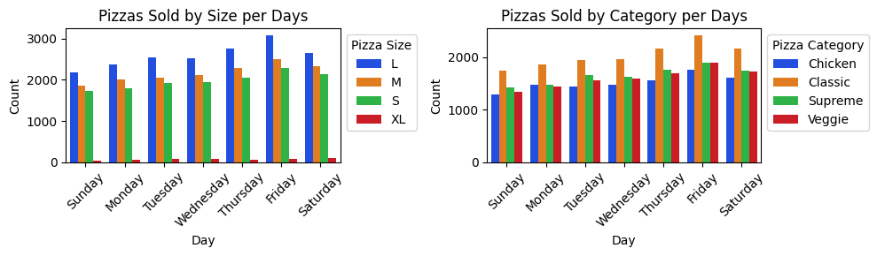
Problem Solving | pizzas sold per day by size and category
Just like monthly sales, the classic and L size pizza categories are still the pizzas with the highest sales per day. Each of the highest peak sales for these two types of pizza occurred on Friday. This shows a positive trend, an evaluation can be carried out to find out why and how the increase occurred.
Of course, the results of the evaluation and analysis obtained need to be applied to sales on other days. with the hope that sales on days other than Friday can experience a significant increase and can even exceed the previous sales peak.

Slide 20
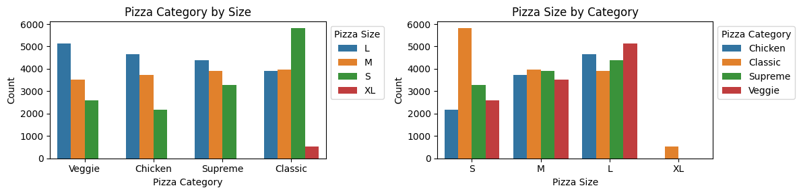
Problem Solving | pizza category by size vs size by category
In this slide is a breakdown of the previous analysis of L-sized pizzas and the classic categories that are the peak sales for each type. As seen in the above graph, the distribution of classic category pizza sales dominates with the highest sales being s-sized pizzas. It can be concluded that pizza sales based on category, S size pizza in the classic category is the pizza that customers are most interested in and makes this category get the highest sales than other categories.
Meanwhile, if we look at the graph of pizza size by category, L size pizza dominates with an even distribution in each category of pizza sold. In contrast to the S size pizza where the distribution is uneven, only the classic category is high. So it can be concluded that pizza sales based on size, the highest and most even sales are for L size pizzas. It can also be seen that XL size pizzas are only sold in the classic category.

Slide 21
Summary | Recommendations
Summary:
There is 47665 total orders There is total 32 unique pizza name Most pizza size shown is L size Most pizza category shown is Classic category The highest sales occurred in July and the lowest in October Extreme sales declines occurred after the month of July to October | There's been five sales increases and seven sales decreases The highest pizza sold by size is the L size pizza with percentage on 38% The lowest pizza sold by size is the XL size pizza with the percentage on just 1% The highest pizza sold by category is classic category with total percentage on 30% The smaller pizza sold by category is the chicken category, with percentage on 22%
Recommendations:
To running identification of problems on monthly trend sales imbalance with the associated divisions
To solve the problems on monthly trend sales by comparing sales per 2 months in a row
To evaluated the sales of pizza with XL size, whether increasing promotions and variations, or choosing to discontinue sales for that type of pizza

Slide 22



Thanks!
Do you have any questions?
Let’s us connect!
yulindratita@gmail.com

